Slide 1

Type providers Language-integrated data
Tomas Petricek, University of Cambridge
Project homepage: http://fsharp.github.io/FSharp.Data
Get in touch: @tomaspetricek | tomas@tomasp.net

Slide 2
software stacks trainings teaching F# user groups snippets mac and linux cross-platform tutorials
F# Software Foundation
F# community open-source MonoDevelop
http://www.fsharp.org
contributions research support consultancy mailing list

Slide 3


FsLab project
Access & analysis
Visualization
F# Data library
First-class data
CSV, REST, WorldBank…
www.fslab.org

Slide 4
What are type providers? Integrating WorldBank and R

Slide 5
The confusion of languages

Slide 6
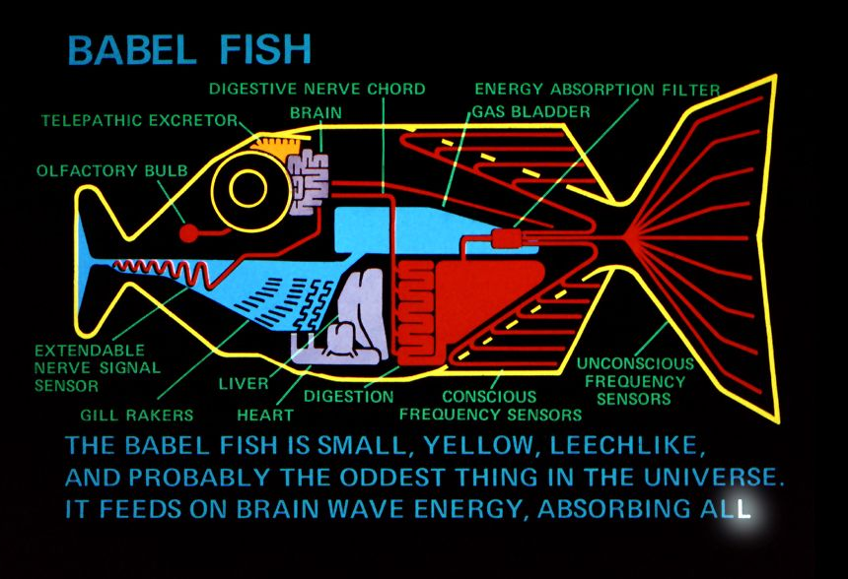
What is a Type Provider?

Slide 7

What are type providers?
$$∅⊢e:τ$$

Slide 8


What are type providers?
$$π( )⊢e:τ$$

Slide 9
Type provider research questions
Data vs. Schema
Laziness
Mapping to types
Schema inference
Schema inference

Slide 10
Schema inference Loading Titanic data from CSV

Slide 11


Inferring primitive types
$$⊤$$
null
bool
int
decimal
string
float
$$τ_{1}+τ_{2}$$

Slide 12
Structure inference Working with XML and JSON data

Slide 13
Inferring structured types
person { name : string }
person { name : string, age : int }
person { name : string, age : int option }
[ { num : int } ]
[ { str : string } ]
int
{ value : int }
[ { num : int option, str : string option } ]
int + { value : int }

Slide 14
Putting it together! Looking at the US government debt

Slide 15

F# Data type providers
First-class data
CSV, REST, WorldBank…
R Type provider
Statistics & visualization
5000 tested packages
www.fslab.org

Slide 16


Deedle data frame
Data exploration
Indexing and aggregation
F# Charting library
Simple & composable
Interactive style
www.fslab.org

Slide 17
Type providers will change the world!
Project homepage: http://fsharp.github.io/FSharp.Data
Get in touch: @tomaspetricek | tomas@tomasp.net

